Slide 1
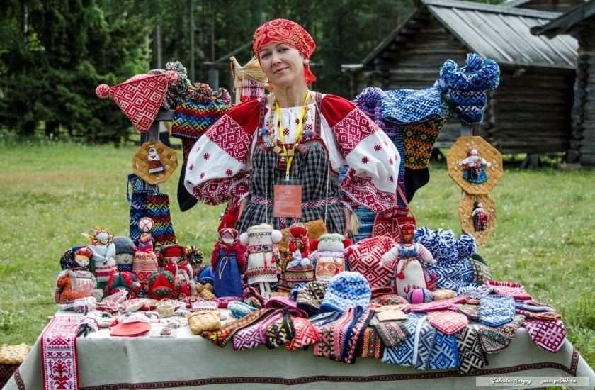
Northern Folk Crafts

Slide 2
Задание по английскому языку для группы 46 на 10 декабря.
1.Записать названия промыслов с переводом
2..Сделать перевод слайдов
3.Рассказать об одном промысле
Задания на 2 пары.Работы прислать 10 декабря к 20.00
Зачет на следующей паре.

Slide 4
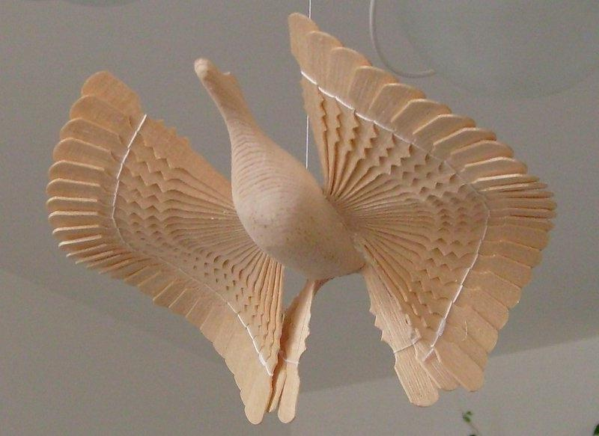
Wood-carving
Since olden times wood has been the most widespread and popular material.
In nearly every Northern home there is chip bird floating under the ceiling. Such birds are made by local craftsmen, with the help of an axe, a knife and a chisel.

Slide 5
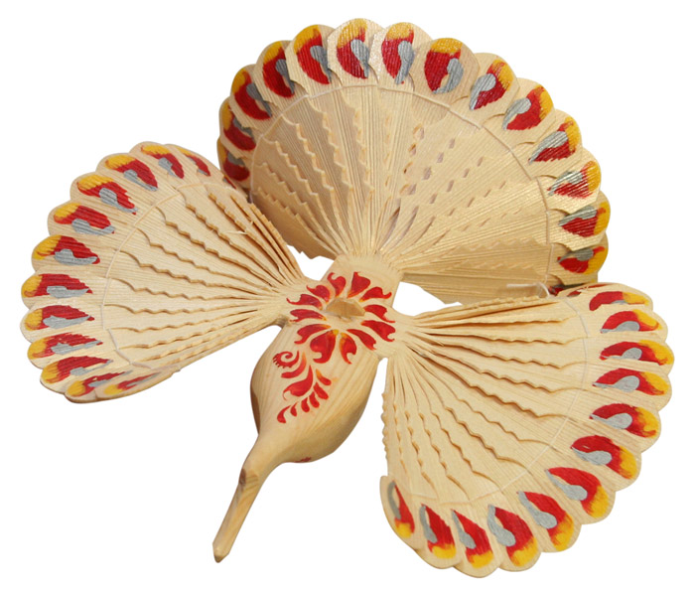
The craftsman takes a pine log, carefully shave it, splits the end into chips and spreads them into a fan so that a bird’s body and a tail emerge.

Slide 6
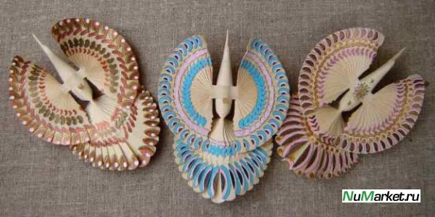
Another log is turned into wings, then the parts are put together and a beautiful bird appears which is said to bring happiness to the home.

Slide 7
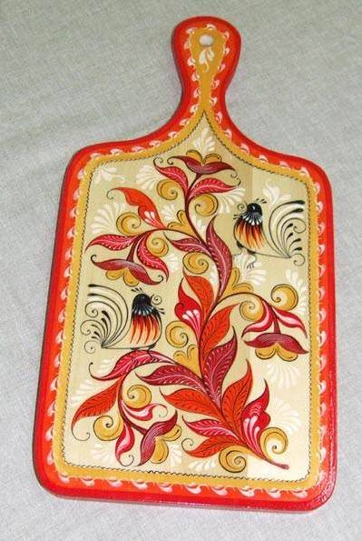
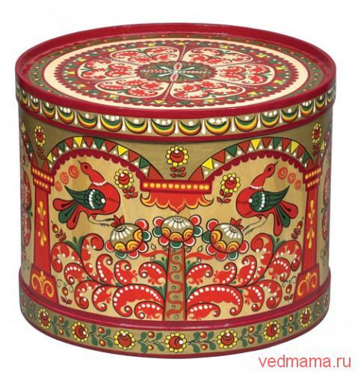
Decorative painting on wood
Besides carving, folk craftsmen painted their household utensils. Distaffs, birch-bark boxes, berry baskets, bread-bins, candlesticks were painted in bright festive colours.

Slide 8
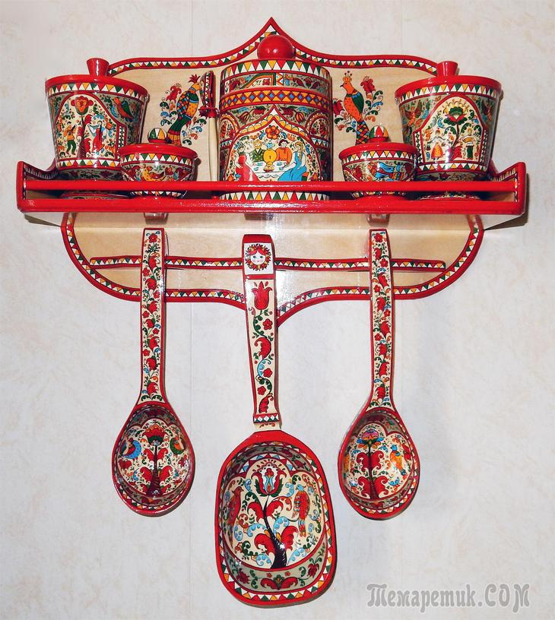
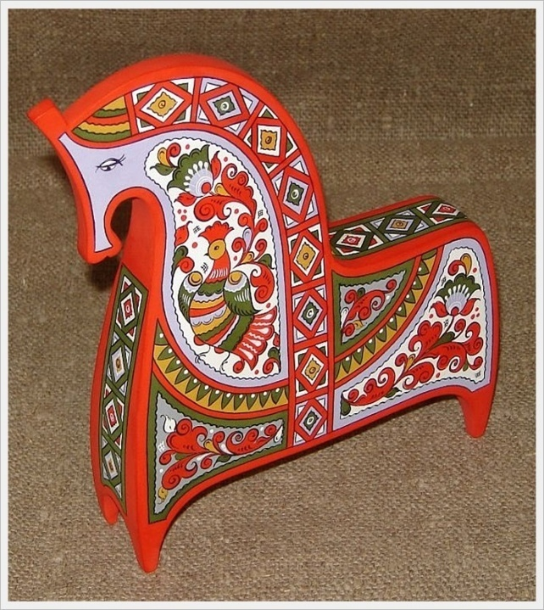
The main theme is the life of the common people, rendered in a highly poetic form.
Some of the wooden objects were adorned with a series of pictures, which, taken together, told a single story.

Slide 9
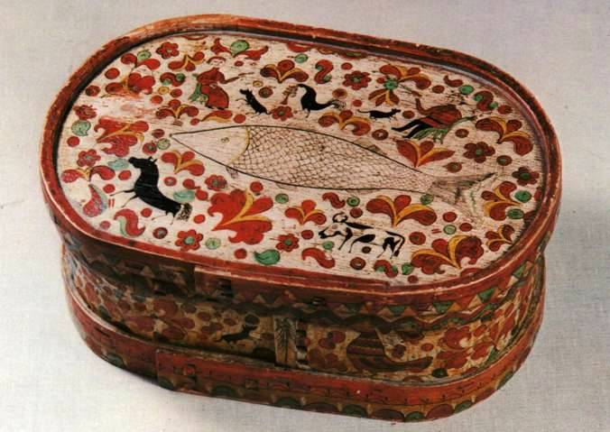
The style of painting varied from one district to another. Northern Dvina painting usually features a floral design framing a scene from every day peasant life.

Slide 10
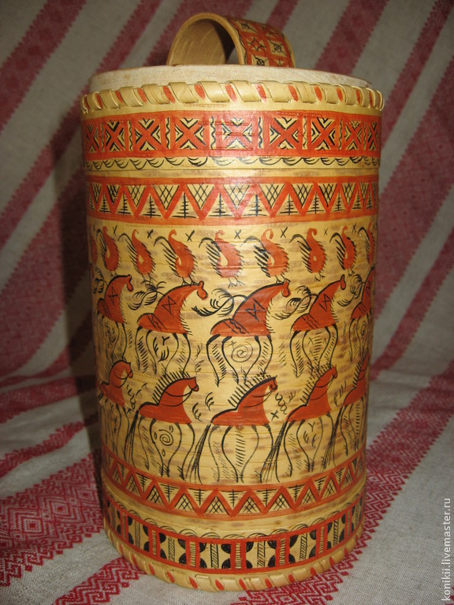
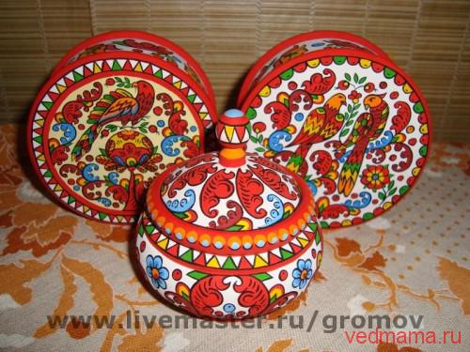
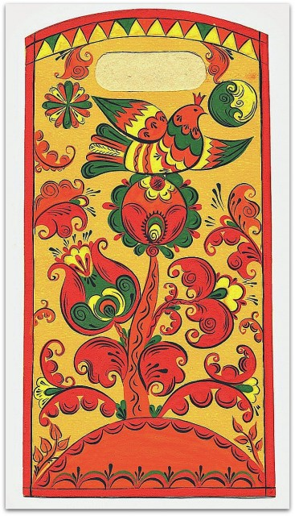
Fine graphic painting is typical of the Mezen river area.
Floral and bird patterns
are characteristics of the dis
distaffs found in the
Kargopolsky district.

Slide 11
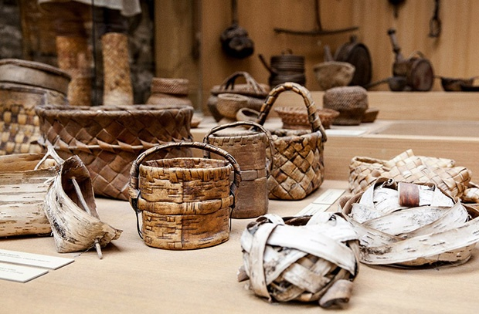
Birch-bark processing
Not long ago one could see birch-bark items almost in every peasant family. They were used for keeping milk and sour-cream, cottage cheese butter, kvass and berries, mushrooms and fish.

Slide 12
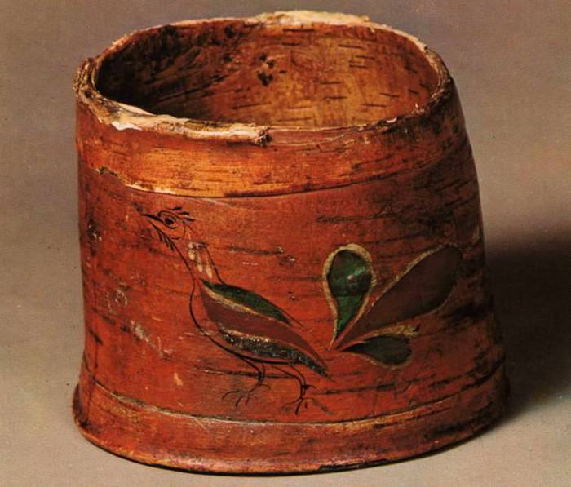
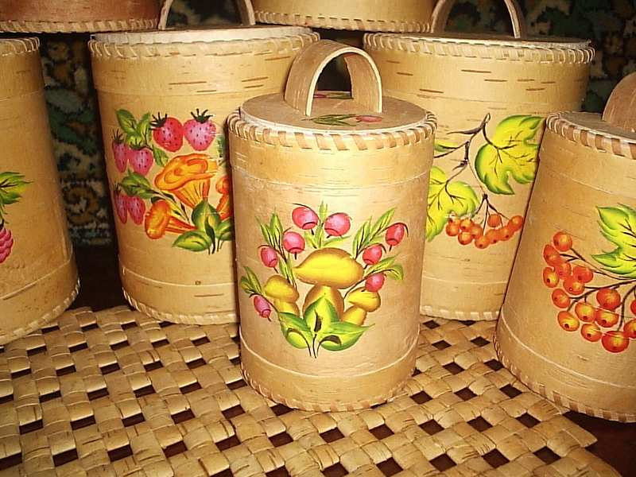
As compared with modern kitchen utensils, birch-bark vessels called tuyesa or buraki have several advantages. Firstly, they are leak proof. Secondly, foodstuffs kept in them can stay fresh for a long time.

Slide 13
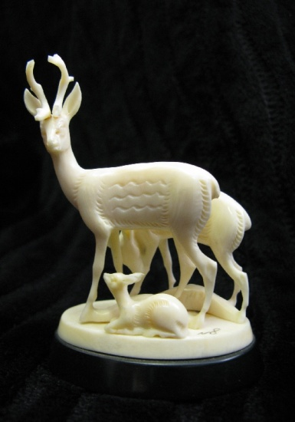
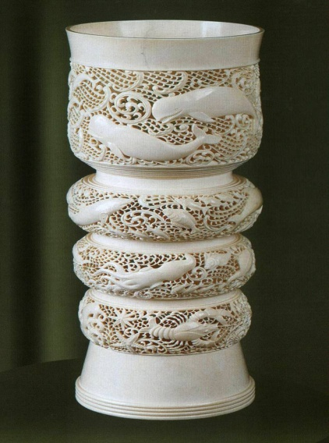
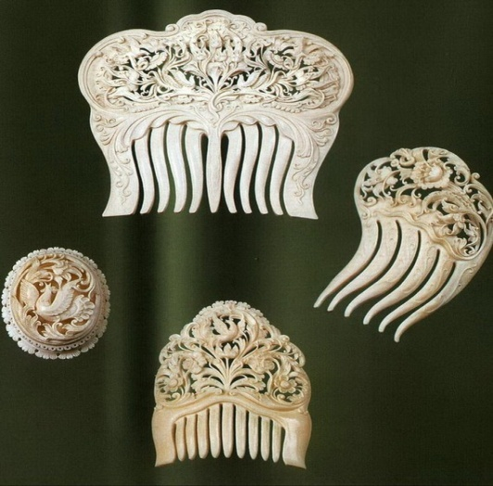
Kholmogory Bone-Carving
The art of Kholmogory bone-carving is a brilliant and original phenomenon in Russian folk culture.
The Northern art of bone-carving, rooted in the ancient past became especially well-known about 400 years ago.

Slide 14
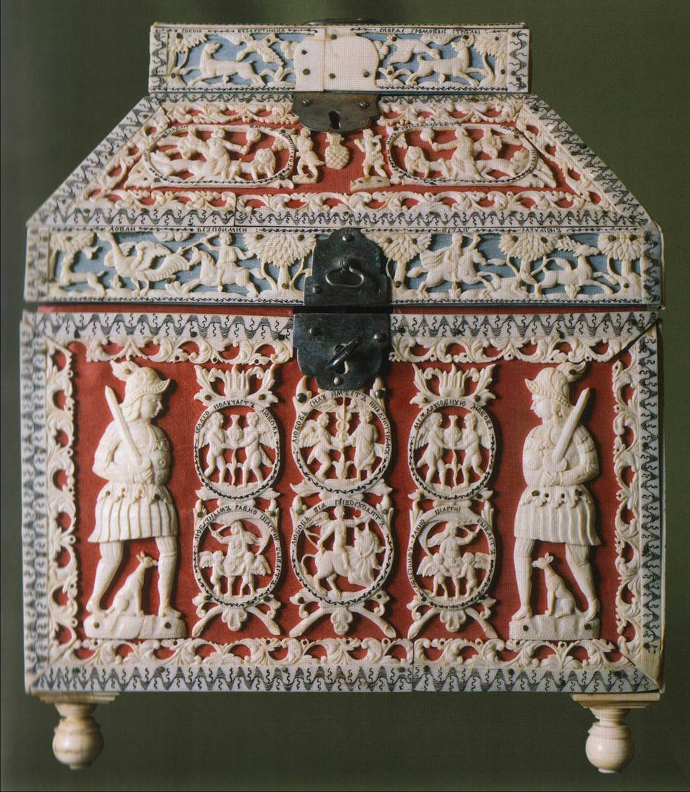
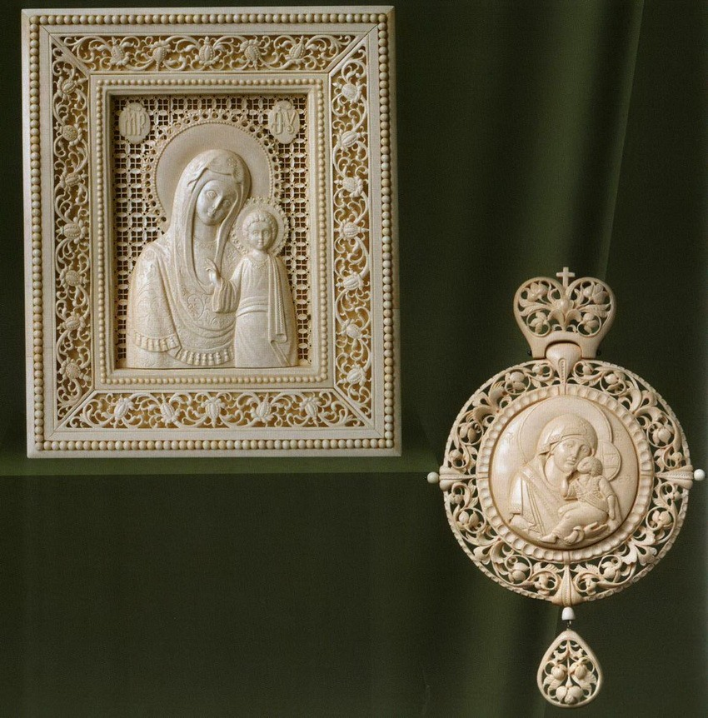
In the 16th-17th centuries bone-carvers from Kholmogory were invited to Moscow to decorate the Armoury in the Kremlin where they worked side by side with foreign masters.
Northern masters used walrus tusk and whale tooth obtained by Pomors while sea-hunting.

Slide 15
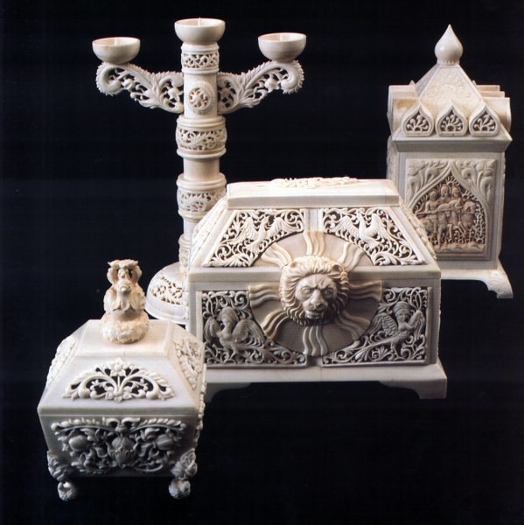
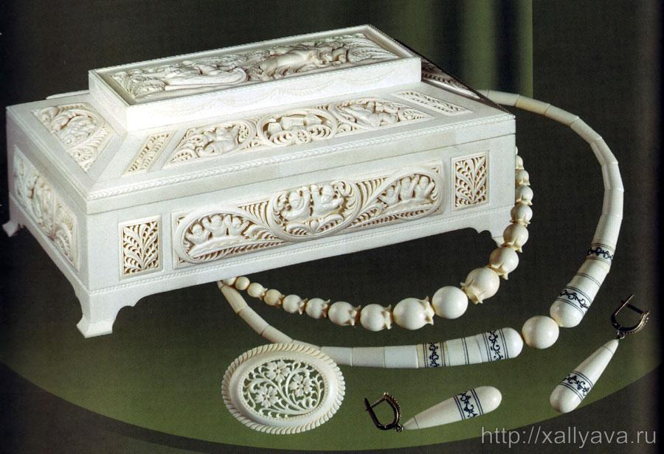
Contemporary masters develop the rich traditions of this ancient northern art. They make unique creations intended for museum collections and articles for sale.

Slide 16
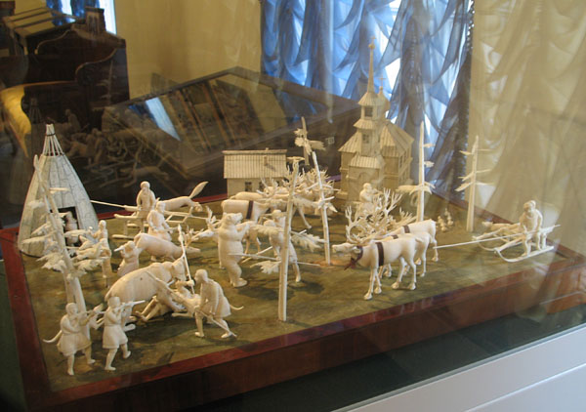

Slide 17
Clay Toys from Kargopol
The art of making clay toys in the town of Kargopol goes back to ancient times: some years ago archeologists dug up duck-shaped whistles which are 5.000 years old.

Slide 18
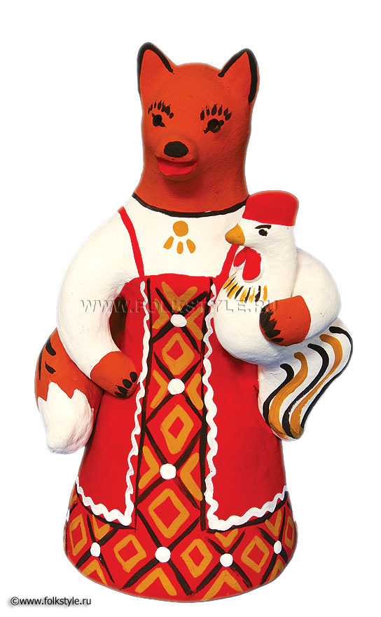
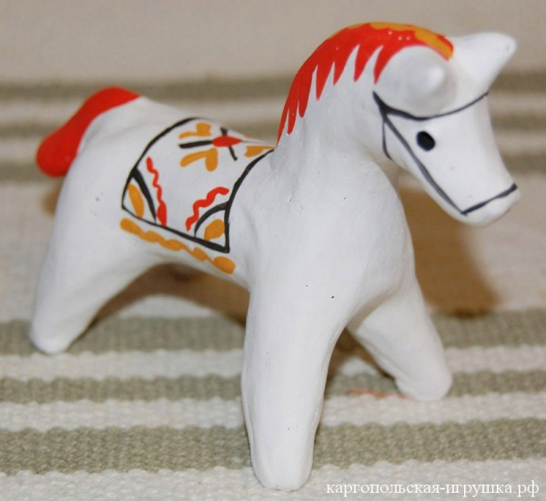
Peasant women, centaurs, cows, horses, deer, rams, hares, bears and ducks were the most typical characters of the toys. In local folklore and rituals all these animals are associated with fertility and solar symbolism.

Slide 19
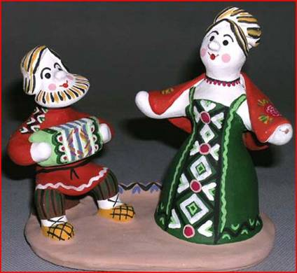
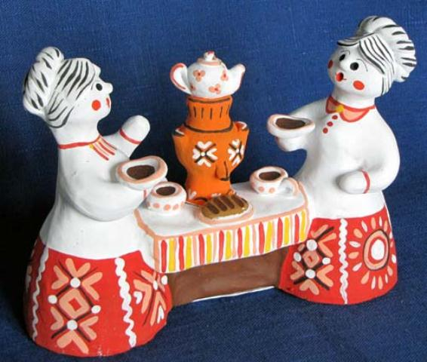
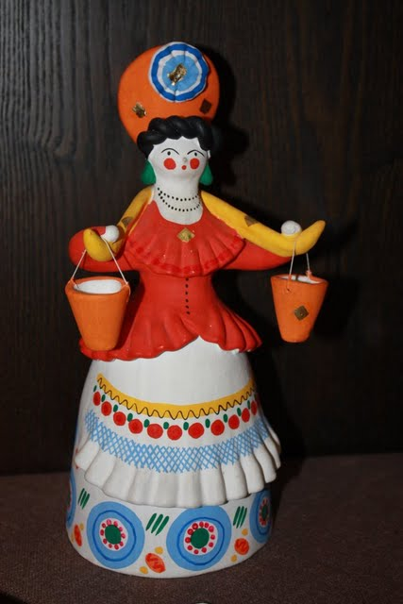
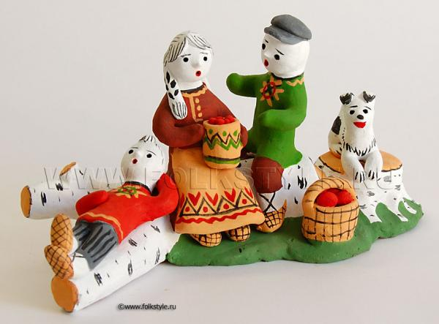
Later on, new motifs appeared, which depict the life of the present-day northern village.

Slide 20
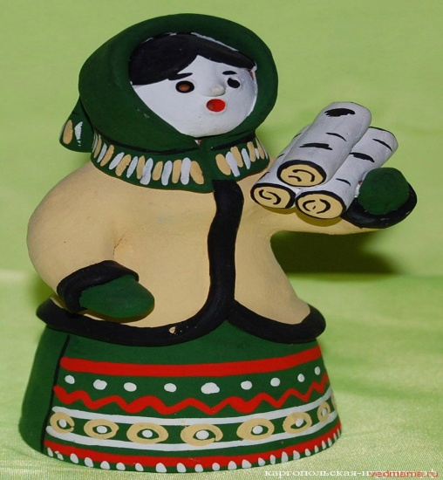
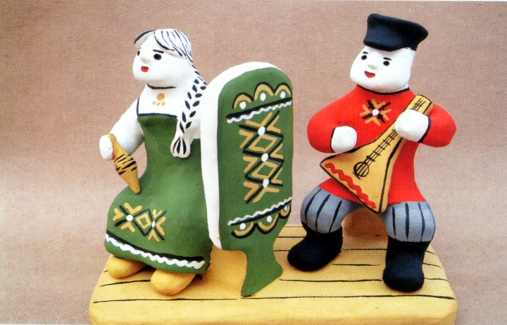
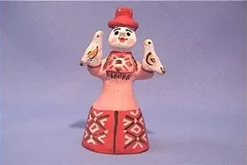
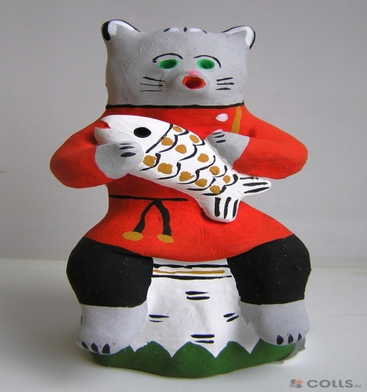
Nowadays, the toys are made by the Kargopol toy-making workshop and individual toy-makers who together help to preserve the ancient Kargopol tradition.

Slide 21
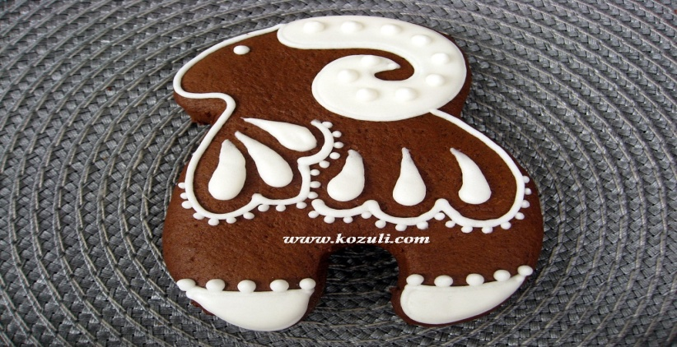
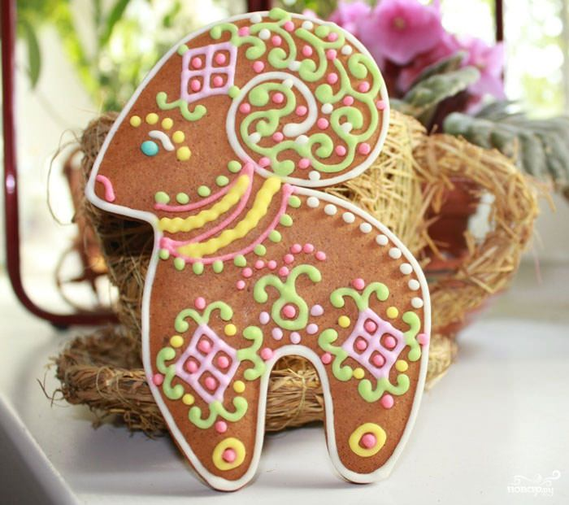
Northern Kozoolyas
Baking pryaniks is another folk craft which is very popular in the North.
Northern pryanics, the so-called kozoolyas occupy the special place. The origin of the word may be explained by the fact that the most popular shape of such pryaniks was that of a sheep or a goat.

Slide 22
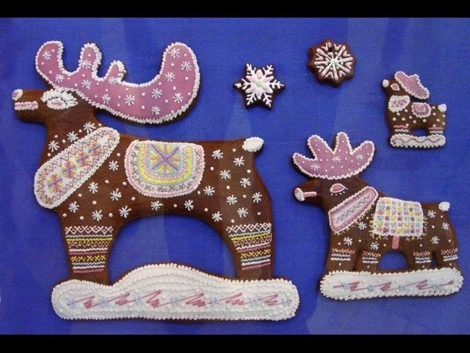
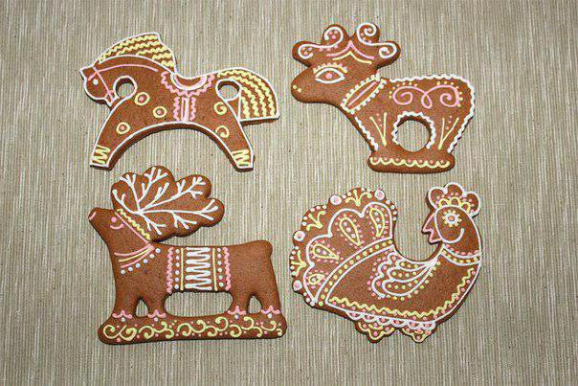
Arkhangelsk kozoolyas vary in shape and colour: they may have the form of a sheep, a horse, a reindeer, Santa Claus, a fir-tree, a basket and so on. They are usually of brownish shade (due to burnt sugar) and are decorated with coloured icing.

Slide 23
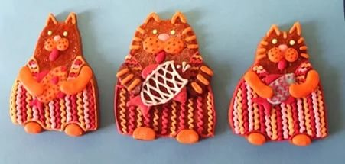
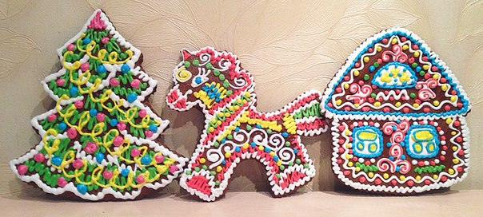

Slide 24
Источники информации
M.A.Amosova, E.E.Glushchenko, L.V.Ripinskaya, N.V.Chicherina “Our Heritage”, Arkhangelsk, The Pomor University Publishing House, 1994.
Интернет-ресурсы.

