Slide 1
PRESENT SIMPLE TENSE
(Простое настоящее время)
https://yadi.sk/i/DXHffLuC6tX8yg

Slide 2
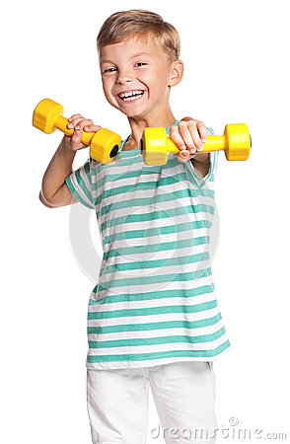
THE PRESENT SIMPLE TENSE
(Простое настоящее время)
Случаи употребления простого настоящего времени:
1. Обычные, регулярно повторяющиеся действия;
I do morning exercises every day.
Каждое утро я делаю зарядку.
https://yadi.sk/d/fOyrX5kJWI05Cw

Slide 3
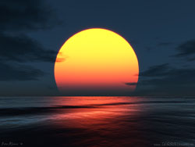
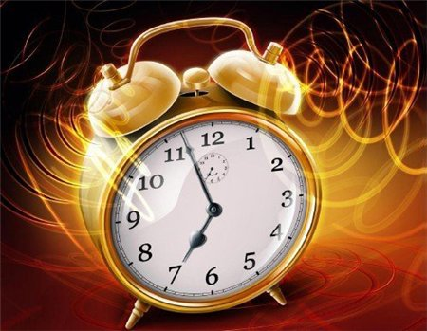
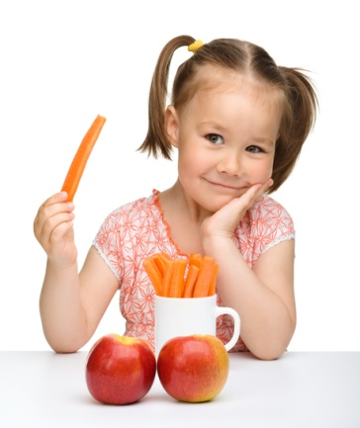
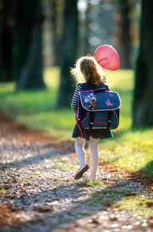
2. Общеизвестная истина;
The sun rises in the East.
Солнце восходит на востоке.
3. Последовательность событий, действий в настоящем времени.
I get up at 7 o’clock, eat breakfast and go to school.
Я встаю в 7 часов, завтракаю и иду в школу.
Указатели времени:
First- сначала
Then- затем
After - потом

Slide 4
Спряжение глаголов в the Present Simple Tense:
Утвердительная форма
Вопросительная форма
Отрицательная форма
I
You
We
They
He
She
It
I
you
we
they
I
You
We
They
work
Do
work?
do not work
(don’t)
he
she
it
He
She
It
does not work
(doesn’t)
works
Does
work?

Slide 5
Change the sentences according to the model.
Model: They play football.- He plays football.
Your friends speak English. – He …
I read a book. – She…
We write letters. – My sister…
You go to school.- Sam…
They get up at nine o’clock in the morning. – Our father…
They have interesting books.- She…
2. Make questions from the sentences according to the model.
Model: We read and write in Russian.- Do we read and write in Russian?
She likes animals.- …
They play football.-…
His mother cooks dinner in the morning.-…
He reads newspapers every evening.-…
You have holidays in summer.-…
https://yadi.sk/d/69S2qDhhflqprg

Slide 6
3. Make negative sentences according to the model.
Use do not (don’t) or does not (doesn’t)
Model: I play chess. (cards).- I do not (don’t) play cards.
Bill plays the piano very well. (guitar) –…
You speak English. (French)– …
The children play football on Mondays. (hockey) – …
Barbara works in London. (live)- …
My father writes novels. (poetry) – …
I swim very well. (dive)- …
4. Choose the verb from the list and complete the text.
watch leave catch do read meet return have get start be
James 1)…. a student. He 2)……..up early every morning and 3) …..breakfast with his family. Then he 4) …………..for school. James 5)………….. the bus to school because his school is far from his home. He 6)….…….. his friends at school before he 7)……….. lessons. After school, he 8)………… home and 9)………his homework. In the evening, he usually 10) ………… TV or 11)……………...a book.

Slide 7
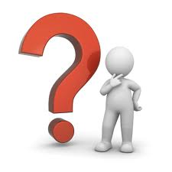
Вопросы и краткие ответы:
Вопросительная форма
Краткие ответы
I
you
we
they
I
you
we
they
I
you
we
they
Do
work?
Yes,
do .
No,
do not (don’t) .
he
she
it
he
she
it
he
she
it
Does
work?
Yes,
does.
No,
does not (doesn’t).
Answer the questions:
1. Do you live in Moscow?
2. Do you get up at 8 o’clock in the morning?
3. Do you watch TV every day?
4. Does your friend play football?
5. Does your mother like tea?
6. Do you always do your homework?
https://yadi.sk/d/YhwSxWdTAypAuA

Slide 8
Thank you for your work

